Slide 1
GAME PITCH
By
Ricardo Costa-Tré
Andrew Kapp
Ash Jurisich

Slide 2
So, What Is The Game?
Roguelike
Dungeon Crawler
Hack ‘n Slash
Crafting Progression

Slide 3
The Gameplay Loop
Kill Enemies
Gather Loot
Craft / Upgrade Weapons
REPEAT!

Slide 4
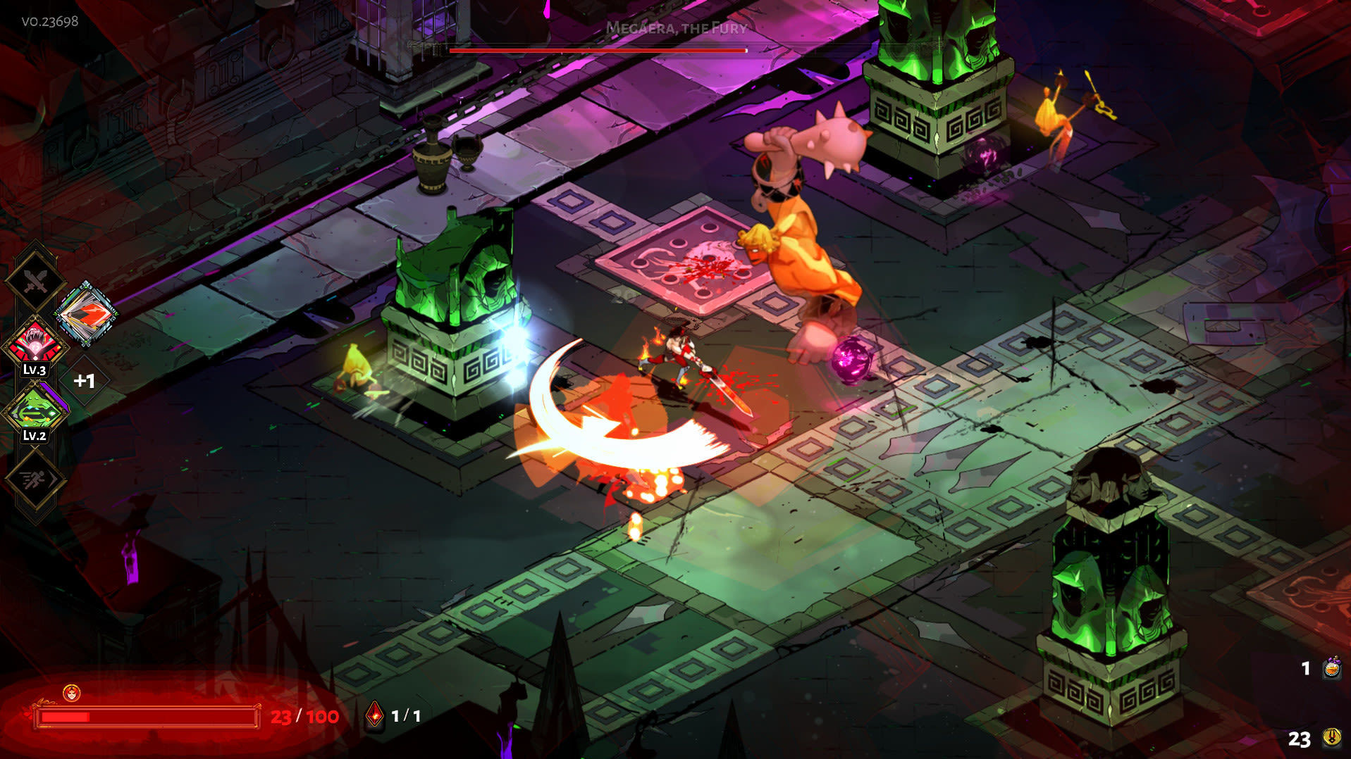
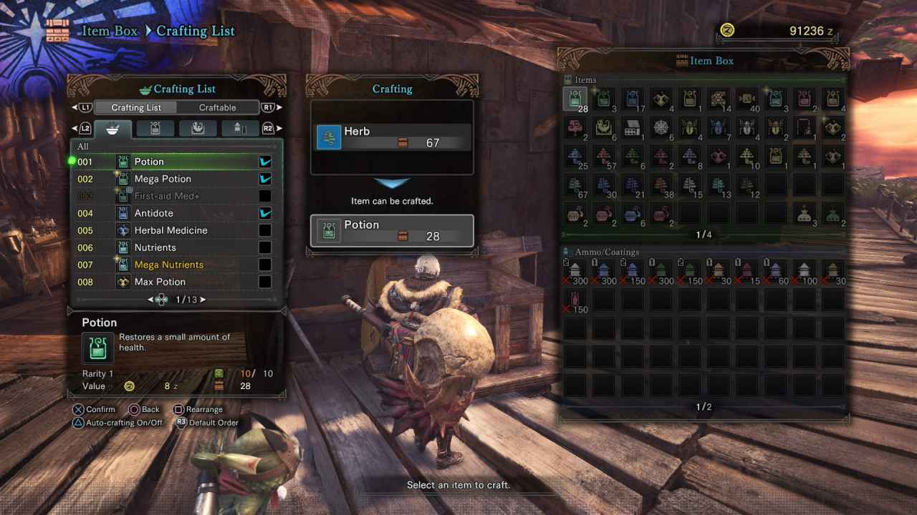
Think ‘Hades’ Meets ‘Monster Hunter’
Enemies Drop Loot for Crafting
Different Weapons and Playstyles
Procedural Generated Dungeons and Rooms
Weapon and Crafting Progression System

Slide 5

But There Might Be More…

Slide 6
Q&A

